Slide 2
Sign Language Translator
Submitted to: Prof. Priyanka Jangde and Prof. Narendra Pal Singh Rathore
Department of Computer Science and Engineering

Slide 3
Supervised by: Prof. Priyanka Jangde and Prof. Narendra Pal Singh Rathore
Team Members
1. Aditya Sharma (0827CS201016)
2. Akshay Keswani (0827CS201022)
3. Amit Kumar Yadav (0827CS201031)
4. Aanya Chourasiya (0827CS201003)

Slide 4
Acknowledgment
We would like to extend our heartfelt gratitude to our Computer Science and Engineering department for providing us with this great opportunity to work on this project.
We would also like to express our sincere gratitude to Prof. Priyanka Jandge and Prof. Narendra Pal Singh Rathore for her valuable guidance and kind supervision throughout the course of this project.

Slide 5
Project Presentation Outline
Abstract
Introduction
Problem Statement
Survey of Existing Systems
Project Objectives
Requirement Analysis
Designs/UML Diagrams
Solution Proposed
The Outcome Discussion
Conclusions and Limitations

Slide 6
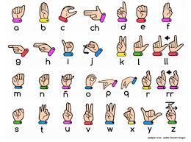
Introduction
The increased public acceptance and funding for international projects emphasizes the necessity of sign language. The desire for a computer-based solution is significant in these age of technology for the deaf people. However, researchers have been attacking the problem for quite sometimes now and the results are showing some promises. Although interesting technologies become available for voice recognition, but there is currently no commercial solution for sign recognition on the market.

Slide 7
Abstract
This Project focuses on a review of the literature on hand gesture techniques and introduces their merits and limitations under different circumstances. The theories of hand segmentation and the hand detection system, may be used to construct hand gesture recognition using Python and OpenCV. The use of hand gestures as a natural interface motivates research in gesture taxonomies, representations, and recognition algorithms, as well as software platforms and frameworks, all of which are briefly covered in this Project

Slide 8
The Problem Statement
This method takes pictures on camera as touch data. The vision-based approach focuses heavily on touch captured images and brings out the main and recognizable feature. Colour belts were used at the beginning of the vision-based approach. The main disadvantage of this method was the standard color to be applied to the fingers. Then use bare hands instead of colored ribbons. This creates a challenging problem as these systems require background, uninterrupted lighting, personal frames and a camera to achieve real-time performance.
In addition, such systems must be developed to meet the requirements, including accuracy and robustness. The Model will be trained by several set of Gestures of sign language using OpenCV and Python API. We will Expand several gestures of hands by our own to train the model. The gestures will be taken by the camera from multiple directions. Several different methods have been tested so far. The first is to build a 3D human hand model.
The model is compared to hand images with one or more cameras, and the parameters corresponding to the shape of the palm and the combined angles are estimated. These parameters are then used to create the touch phase. The second is to take a picture using the camera and extract certain features and those features are used as input in the partition algorithm to separate. To use the Model, the user shows some hand gestures in front of the camera. Upon encountering similar gestures in database, the model will show text/sentence as output representing the translation of the sign language. Upon encountering any gesture that is not present in the database, the model will display an Error message.

Slide 9
Survey of Existing Systems
Based on our review, HMM-based approaches have been extensively explored in prior research, including its modifications. Deep Learning, such as Convolutional Neural Networks, has been popular in the past five years. Hybrid CNN-HMM and completely deep learning systems have yielded encouraging results and provide avenues for additional research. Clustering and high computational needs, however, continue to stymie their adoption.
The output of the sign language will be displayed in the text form in real time. This makes the system more efficient and hence communication of the hearing and speech impaired people easier. The images captured through web cam are compared and the result of comparison is displayed.
It is required to make a proper database of the gestures of the sign language so that the images captured while communicating using this system can be compared. For making the database, we would be capturing each gesture from more than 2 angles so that the accuracy of the system will be increase significantly. The more angles you take, the better is the accuracy and the more amount of memory is required.

Slide 10
Objectives
The goal is to make computers to understand human language and develop a user-friendly human computer interface (HCI). Some steps toward this goal include teaching a computer to recognize speech, facial emotions, and human gestures. Gestures are the nonverbally exchanged information. Gesture recognition is an aspect of human-computer interaction that demonstrates an academic treatise and is a vital to popularizing the notion of a human-to-human connection, open dialogue, that must imply the correlation between the user and the machine.
Gesture analysis is a scientific field that can recognize gestures such as hand, arm, head, and even structural motions that usually entail a certain posture and/or motion. Using hand gestures, the individual may send out more information in a shorter amount of time. Several approaches were explored to apply computer-vision ideas to the real time processing of gesture outputs. The Computer Vision study concentrates on gesture recognition in the open CV framework using the Python language.
Language is a huge part in communication. Languages are useless to a person with a disability. Gesture is a vital and meaningful mode of communication for the visually impaired person.

Slide 11
Requirement Analysis
Windows computer or Linux
Python Version 3.6 or above
CMOS sensor (Webcam)
Python Installed Windows Operating system or Linux Os Machine.
Hardware & Software Requirement - Windows computer or Linux, Python installed and Libraries, CMOS sensor (Webcam) , Python Installed Windows Os or Linux Os Machine.
Data Collection – The first step is the data-set collection. We collect the full frame (RGB) image and the corresponding depth map from the camera. It actually understands the gesture and finger positions and update it in the Database where all relevant Collection of images are stored.
Collection of Gestures in Database – The set of all Images conveying the same message will be grouped together as an entity in the database, thus the Database will serve as a collection of multiple number of entities, each of which represents a set of actions / gestures of hand conveying a message

Slide 12
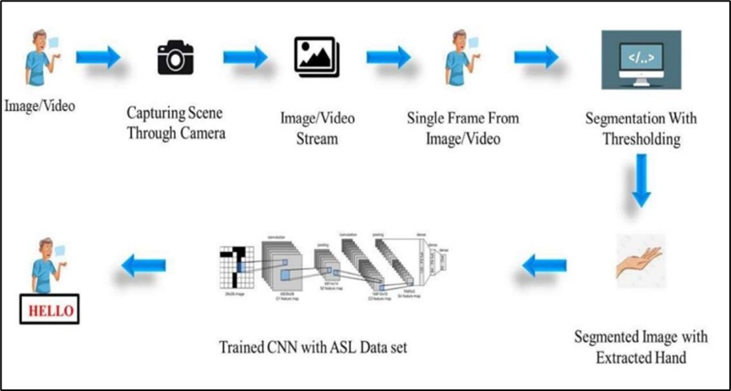

Slide 13
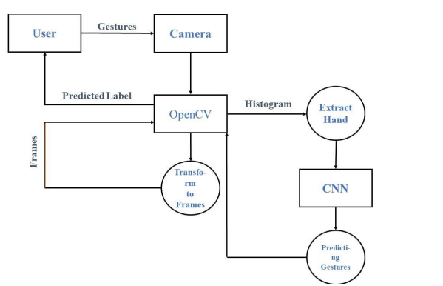
Designs/UML diagrams
Data flow diagram for sign language recognition

Slide 14
Solution Proposed
Hardware & Software Requirement - Windows computer or Linux, Python installed and Libraries, CMOS sensor (Webcam) , Python Installed Windows Os or Linux Os Machine.
Data Collection – The first step is the data-set collection. We collect the full frame (RGB) image and the corresponding depth map from the camera. It actually understands the gesture and finger positions and update it in the Database where all relevant Collection of images are stored.
Extraction of Hand-Gesture – The Set of relevant images will be processed and assigned a Message that the particular sign language will be conveying. All the images from multiple angles having similar Messages will be grouped together and will be assigned the Text message to be displayed in the Model.
Collection of Gestures in Database – The set of all Images conveying the same message will be grouped together as an entity in the database, thus the Database will serve as a collection of multiple number of entities, each of which represents a set of actions / gestures of hand conveying a message.
Hand-Gesture Recognition using Deep Learning – Upon User encounter with the model, the user will show hand gestures in front of the camera. Using OpenCV, those images will be processed and compared with pretrained and pre-processed set of images.
Upon any image in database getting matched with the Gesture, the Mapped Text message linked with the gesture will be displayed on the screen in the form of Text/sentence.
If the gesture performed by the user does not matches any linked image in the database, in
that scenario, and Error message will be displayed on the screen of the user

Slide 15
The Outcome Discussion
Upon training the image dataset without any augmentation, the training accuracy achieved was very high (around 99%) but, the real time performance was not up to the mark. It was predicting incorrectly most of the times because in real time hand-gestures were not placed exactly at the center and aligned vertically. In order to overcome this shortcoming, we trained our model by augmenting our dataset.
The training accuracy was reduced to 89% but the real-time predictions were predominantly correct. The Model can provide an efficient and accurate way to convert sign language into text or voice has aids for the hearing impaired for example, or enabling very young children to interact with computers (recognizing sign language), among others. The Model is capable to Provide Real Time Functioning, Portability and has no need of Calibration. In future work, large scale proposed system can be developed and implemented using Python. Image processing part should be improved so that system will be able to communicate in both directions i.e.it should be capable of converting normal language to sign language and vice versa.
We will try to recognize signs that include motion. Moreover, we will focus on converting the sequence of gestures into text i.e., word and sentences and then converting it into the speech which can be heard. Also, when we increase our training image size the accuracy betters itself both during training and real time implementation. However, training images with large size is directly proportional to the computational power of the system

Slide 16
Conclusion and Limitation
The aim of this project is to predict the ISL alphanumeric hand-gestures in real time. The above work shows that it can be solved with better accuracy when we actually consider the segmented RGB hand-gestures. By applying depth-based segmentation we remove the overheads of dynamic background. The segmented RGB hand-gestures were fed to 3 layered CNN for training and testing in real time.
We were able to achieve training accuracy of 89.30% and testing accuracy of 98.5%. Our model may show good accuracy while predicting results both offline and online. Our project aims to make communication simpler between deaf and dumb people by introducing Computer in communication path so that sign language can be automatically captured, recognized, translated to text and displayed it on Screen. There are various methods for sign language conversion.
Some of them use wired electronic glove and others use visual based approach. Moreover, we will focus on converting the sequence of gestures into text i.e. word and sentences and then converting it into the speech which can be heard.

